Slide 1

CTIS 365: Applied Data Analysis
Burcu Alper
office: E114
e-mail: burcu.alper@bilkent.edu.tr

Slide 2


Slide 3
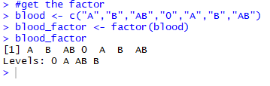


Factors
Factors are like the categorical variables. In factors, there could be different types of categories and in R it is called levels.
- People’s blood type can be given as an example; A, B, AB, O

Slide 4
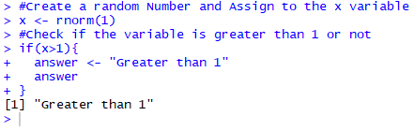
The if Statement

Slide 5
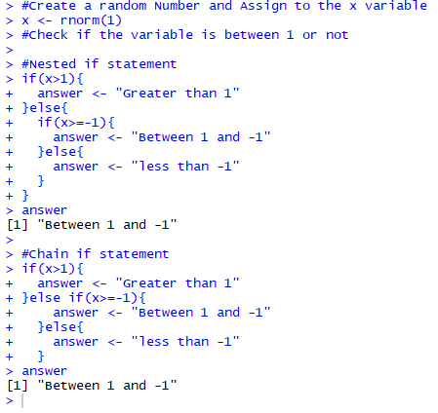
The if Statement (cont.)

Slide 6
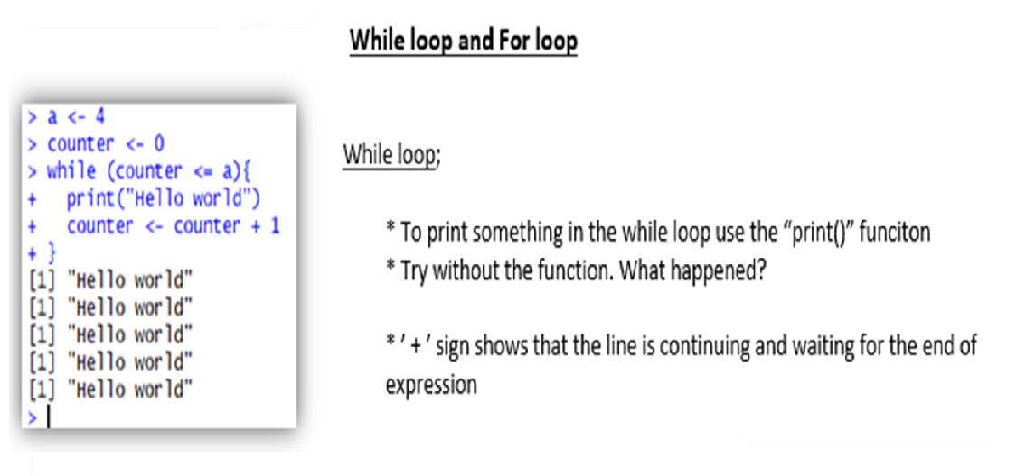
While Loop and For Loop

Slide 7
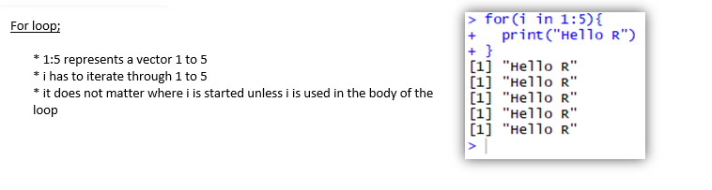

Slide 8
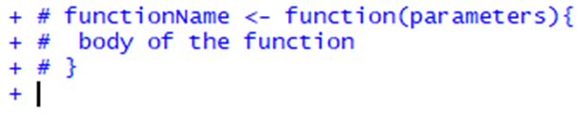
Creating New Function
Functions in R have the same purpose as in other programming languages.

Slide 9
Data Import
There are two methods to achieve this:
Choose file manually;
To read a file in a table format and create a data frame, read.csv(file.choose()) function is used.
Set working directory and then read file
With getwd()function check the working directory and change it with setwd()function if it is necessary. Read the file by using read.csv("filename") function.

Slide 10
Data Import (Cnt.)
Read from a .txt file
read.delim()
By default it sets the sep(separator) argument to “\t” and header argument to TRUE.
data <- read.delim(file=”dataFile.txt”,header=FALSE,sep=”,”)
#No header for dataFile.txt
read.table()
By default it sets the sep(separator) argument to “ ” and header argument to FALSE.
data <- read.table(file=”myData.txt”,header=TRUE,sep=”,”)
We can also use read.table() function to read data from a url.
data <- read.table(url(myUrl),header = TRUE)

Slide 11
Data Import (Cnt.)
Read from an excel file with xlxs extention(xlxs, readxl packages needed)
read.xlsx()
mydata <- read.xlsx(“meyExcel.xlsx”,1)#1 is for number of sheet
mydata <- read.xlsx(“meyExcel.xlsx”,sheetName=“sheet1”)
we can use excel_sheets() to get the names of sheet in the excel.
Read from an excel file with csv extention
read.csv()
mydata <- read.csv(" mydata.csv")

Slide 12
Detecting missing values
is.na(x) # returns a logical vector which if there is missing value returns TRUE
y <- c(1,2,3,NA)
is.na(y) # returns a vector
Detecting missing values
mydata$v1[mydata$v1==99] <- NA # Assigning NA to a variable that is 99
mydata$v1[is.na(mydata$v1)] <- 0 # Assigning 0 to NA variables

Slide 13
Removing missing values
The function na.omit() returns the object with list wise deletion of missing values.
# Creating a new dataset without missing data
newData <- na.omit(mydata)
mean(newData) # returns 2
mean(y) # will return NA
mean(y, na.rm=TRUE) # returns 2

Slide 14
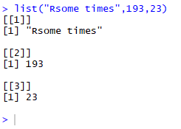
Lists
Vector: 1D, same type
Matrix: 2D, same type
List
● Different R objects
● No coercion

Slide 15
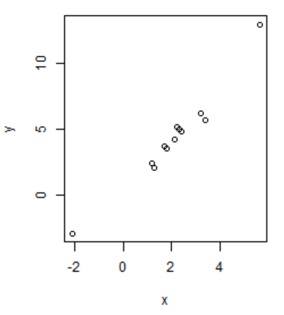
Plot
Plot(...) is a generic X Y plotting function. It's usage is:
plot(x, y = NULL, type = "p", xlim = NULL, ylim = NULL, log = "", main = NULL, sub = NULL,
xlab = NULL, ylab = NULL, ann = par("ann"),
axes = TRUE, frame.plot = axes, panel.first = NULL, panel.last = NULL, asp = NA, ...)
x,y:Vector of coordinates First let's make a simple plot: x <- c(1.2,3.4,1.3,-2.1,5.6,2.3,3.2,2.4,2.1,1.8,1.7,2.2)
y <- c(2.4,5.7,2.0,-3,13,5,6.2,4.8,4.2,3.5,3.7,5.2)
plot(x,y)

Slide 16
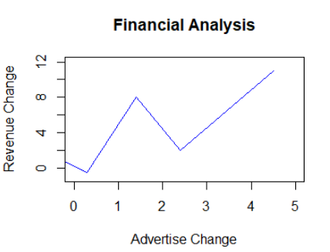
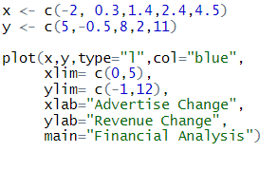
Plot(Cnt.)
Let's use less points and plot with line connections. We will use blue colored line and points, and with axis labels both to X and Y axis as well as a main title of the plot:
For more: http://www.endmemo.com/program/R/plot.php

